Slide 1
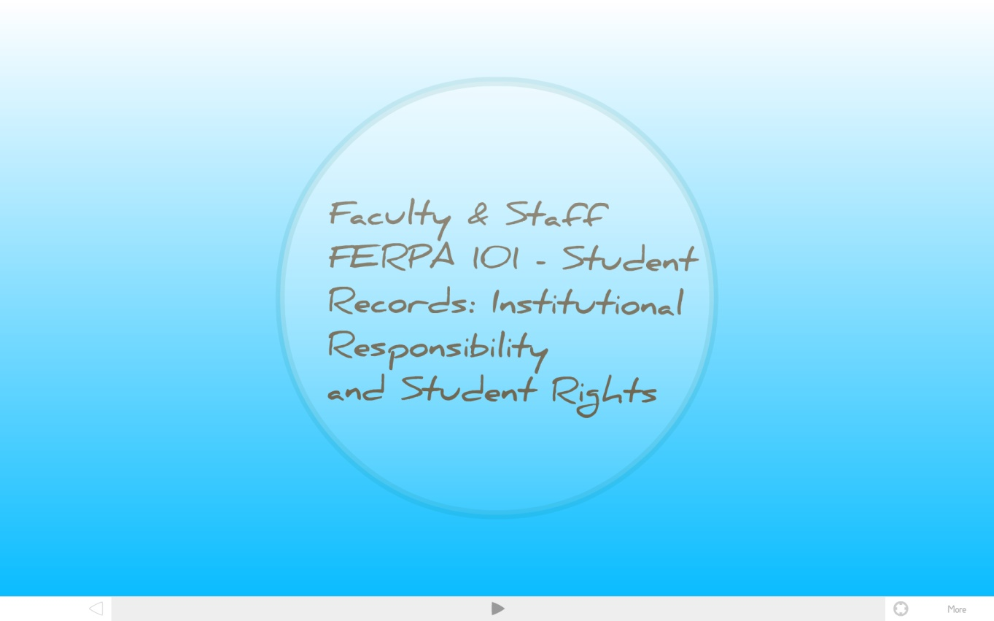
SANTA MONICA COLLEGE DISTRICT
Developed by:
Human Resources
February 2011
Notes:
This presentation introduces you to the Family Educational Rights & Privacy Act, or FERPA as it is more commonly known. This presentation should take approximately 5-10 minutes to complete and will touch on some of the basics you need to know to apply FERPA at SMC.

Slide 2
Notes:
As already noted, FERPA stands for the Family Educational Rights & Privacy Act. It governs access to student records and prescribes how to maintain their confidentiality

Slide 3
Resources:
Compliance with Family Educational Rights and Privacy (FERPA)
Board Policy 4135 (link)
Administrative Regulation 4135 (link)
Notes:
By law, Santa Monica College is required to comply with FERPA.
If SMC should fail to follow FERPA rules, it could lose all federal funding.
Additionally, the College and its staff could be charged with breech of FERPA mandated confidentiality of student records.

Slide 4
Notes:
In addition, California Education Code law also applies, requiring SMC to annually notify students of
the type of records being kept,
the school official responsible for each type of record, and
the criteria used in defining who has access.
Additionally, policies for reviewing, purging, changing and challenging these records must be explained.

Slide 5
Notes:
So, what rights does FERPA convey to the student?
Under FERPA, a student can expect that information in educational records, including electronic records, will be kept confidential and disclosed only with their permission or as required by law.
The information includes:
Grades
Enrollment records
Classes currently scheduled and/or previously completed
Class lists
Personal identification numbers (PIN)
Social Security Numbers (SSN)
Student employment and payroll information

Slide 6
Notes:
There are some basic rules that apply in all circumstances:
First, faculty or staff only should have access to student information necessary for completing their job responsibilities. Access must be governed by a strict NEED-TO-KNOW policy.
All records deemed educational records must be kept confidential and MAY NOT BE RELEASED WITHOUT THE STUDENT’S WRITTEN CONSENT.
FERPA denies ACCESS TO PARENTS OF COLLEGE STUDENTS, REGARDLESS OF AGE, unless it is part of Directory Information or access is authorized in writing.
It is the responsibility of all SMC employees to maintain the confidentiality of student records.

Slide 11
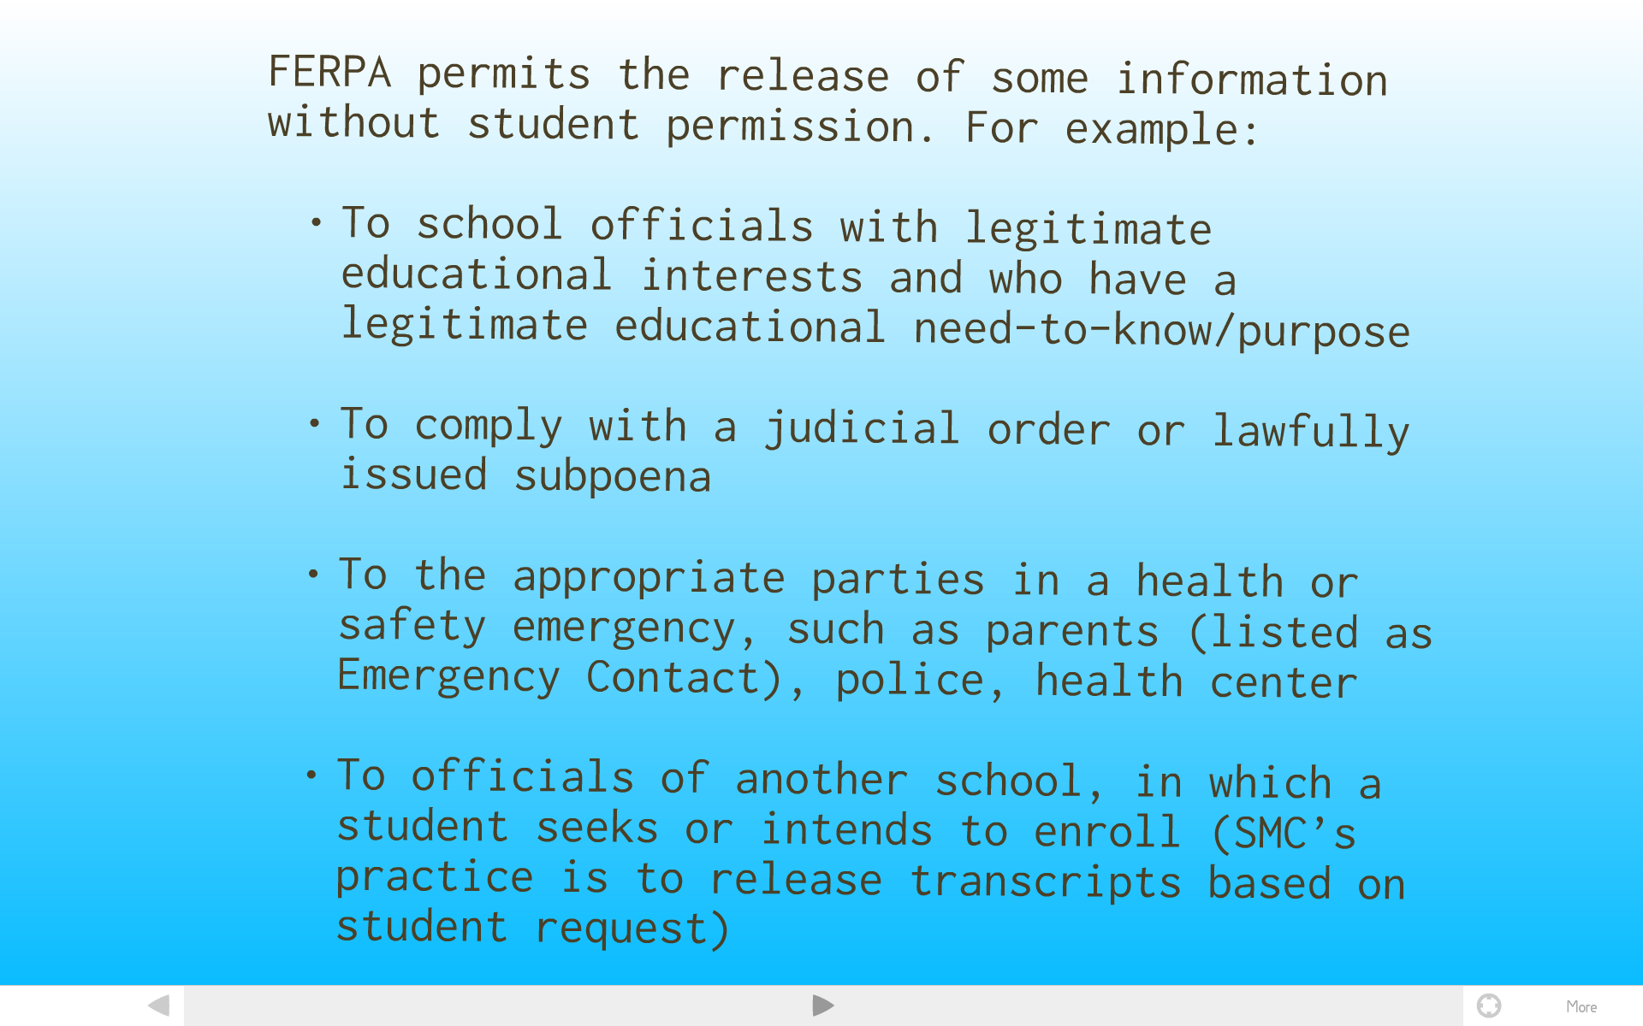

Slide 12
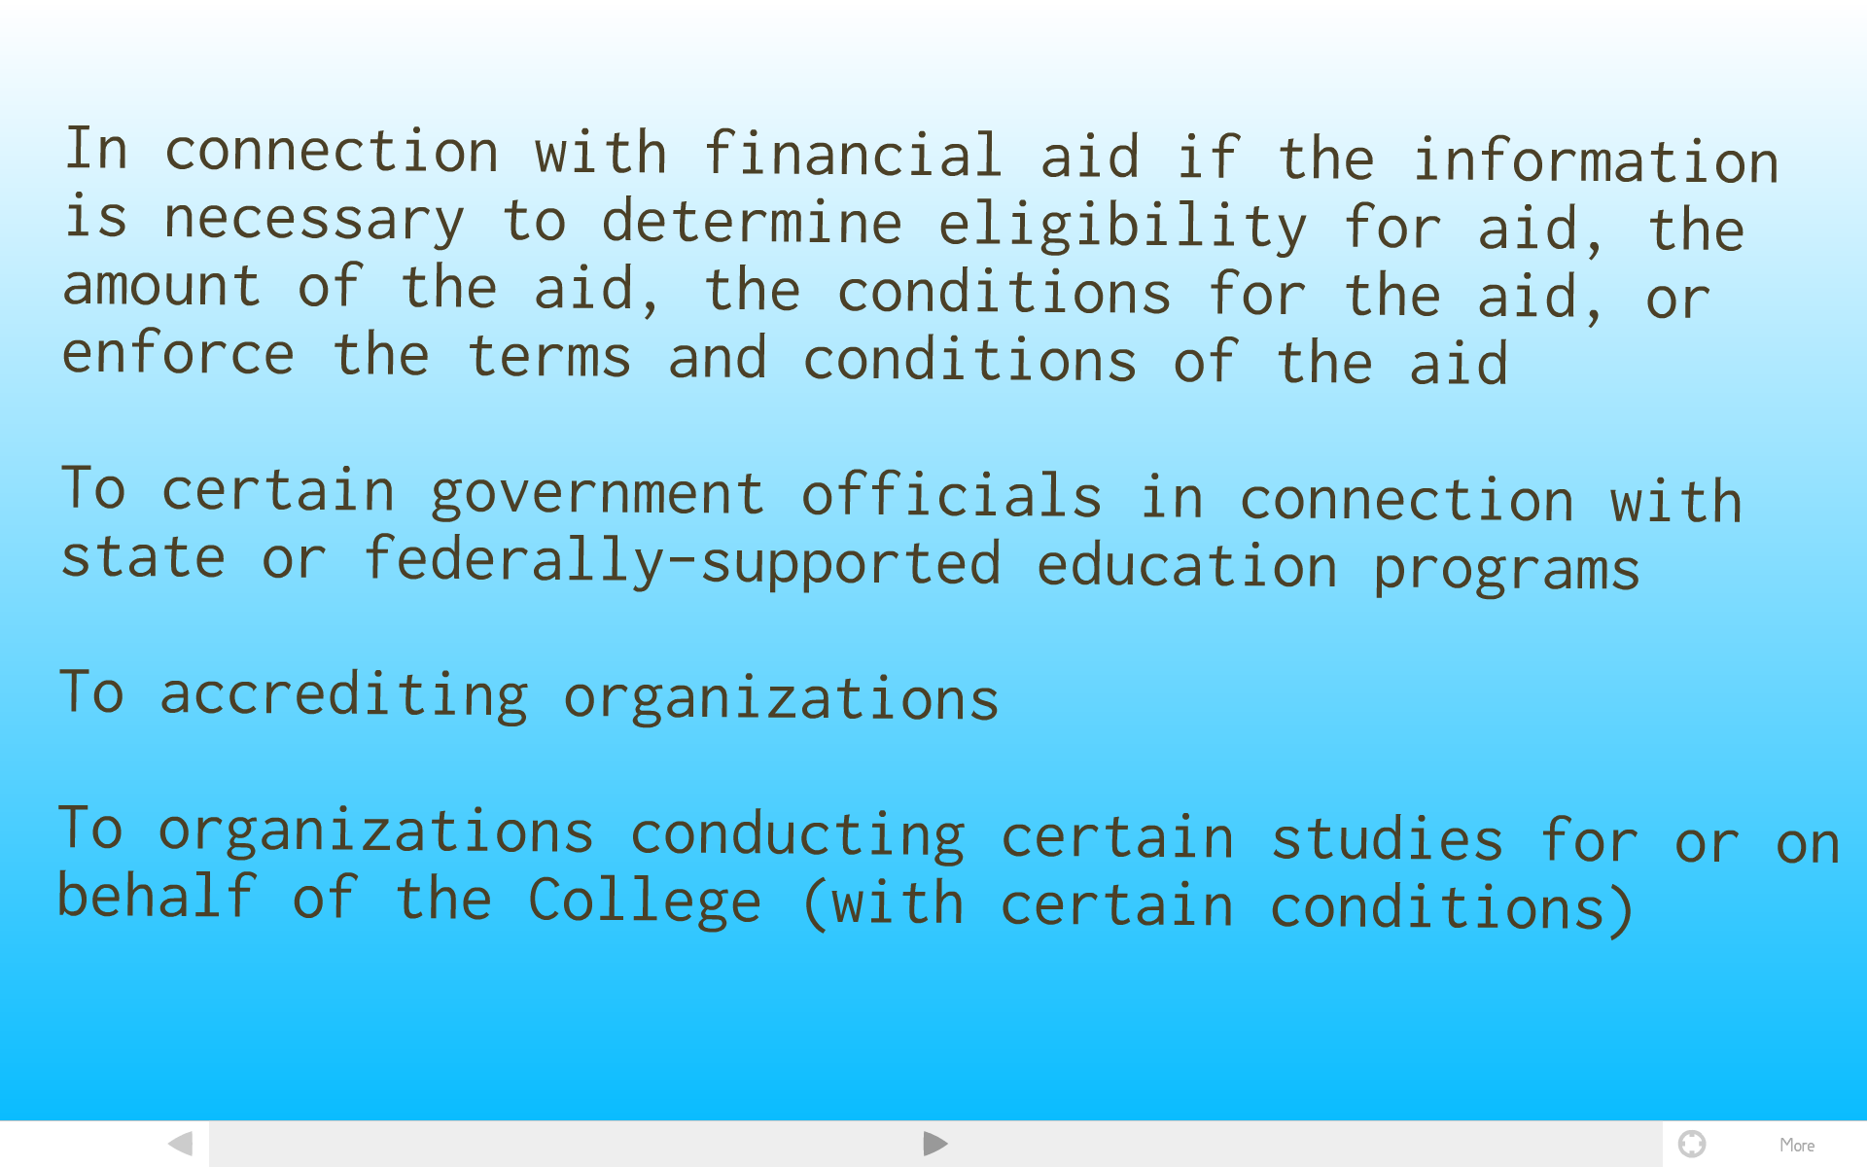

Slide 18
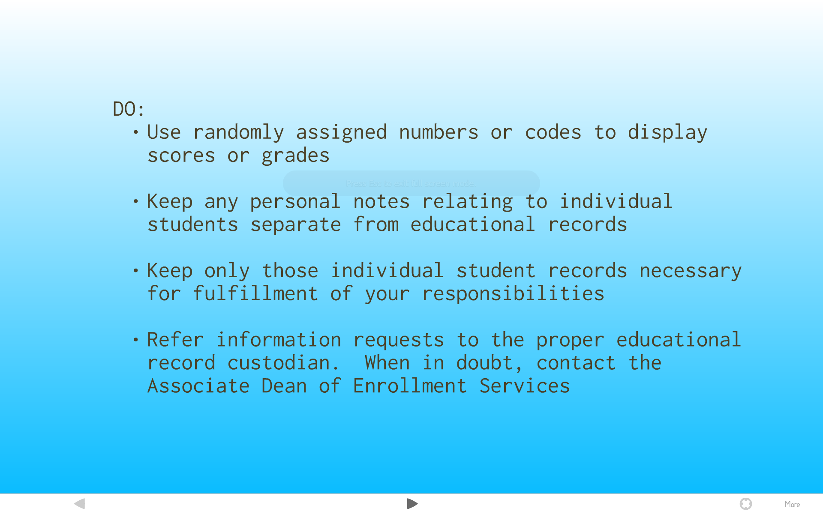

Slide 20
For guidance:, contact:
Esau Tovar, Ph.D.
Dean of Enrollment Services
Tovar_esau@smc.edu
310-434-4012

